Slide 1
Improving Tomorrow's Health Communications Toolkit
Driving public conversation on the use of NHS patient data for research

Slide 2
Introduction
The Wessex Secure Data Environment (Wessex SDE) is an online platform where large amounts of NHS patient data will be safely stored, linked together, and made accessible to researchers to improve services and treatments. The project is being led by University Hospital Southampton with input from all parts of the local NHS.
We genuinely want to know what people across Wessex think about the project and need your help to do this.
The idea of the Wessex SDE is to help researchers to develop life-saving treatments and medicines and improve the way the NHS works for patients, but we need to do this in a way that everyone feels comfortable with.
That’s why we’re starting the Improving Tomorrow’s Health campaign, asking people to let us know their thoughts, questions and concerns about using NHS data for research. We’ll then take this into account as we develop the project.
We need your help to share information about the campaign. We’ve already spoken to hundreds of people and engaged with local groups across Wessex but it’s critical we go further.
We’ve created this toolkit to help you spread the word. It includes everything you need—social media posts, newsletter copy, and creative assets—to support the campaign on your own channels and with your networks. Your help is crucial to ensure everyone in Wessex has the opportunity to have their say on this important initiative.
If you have any questions or require additional materials, please don’t hesitate to contact the team at wessexsde@uhs.nhs.uk. Our full contact details are at the end of this document.
Thank you for your support!

Slide 3
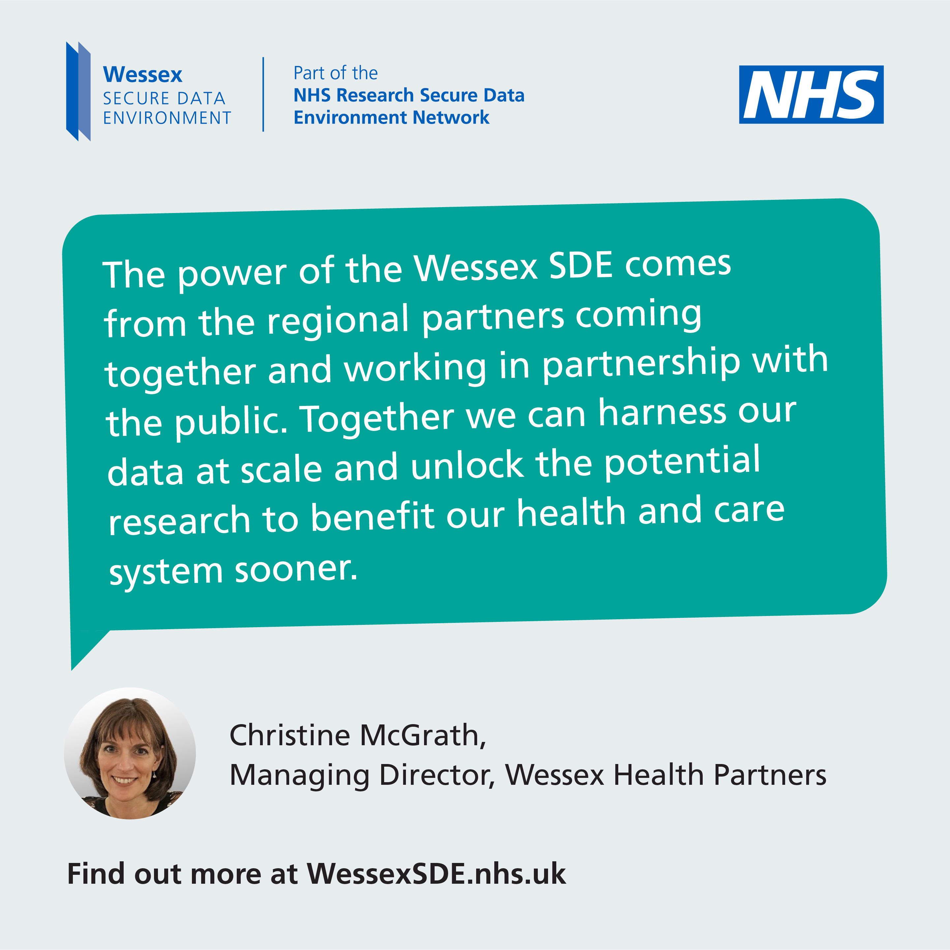
Contents
Top tips for using this toolkit
Social content
Newsletter copy and listicles
Onsite collateral
Speakers for your events
Additional content
Contact us

Slide 4
Top tips for using this toolkit
Use what works for you
You can pick and choose which types of content work best whether it's requesting leaflets or using social posts.
Invite debate
If you're on social media, use our poll and social content to spark debate. Tag partners and use campaign hashtags to amplify your reach.
Stick to the messages
Please use the provided content as it is to keep the messaging consistent and accurate. Most importantly, ensure there is a clear call to action – we want people to go to the website and share their thoughts: wessexsde.nhs.uk/have-your-say/
We can answer any questions
If you receive queries about the SDE, we’ve created a helpful FAQ on our website. Or if you’d prefer, simply refer them to the campaign team - we’re here to help!
Track and share engagement
Monitor how your audience interacts with the campaign (e.g., likes, shares, and comments). We would greatly appreciate it if you could share your engagement insights with the campaign team.

Slide 5
Find the toolkit online
You can find all the toolkit materials online, including PDF and PowerPoint versions of this document.
Visit the toolkit.

Slide 6
Social content
This section features content you can use at any point to show your support on social media and a content calendar designed for specific weeks of the campaign. Don’t worry if you can’t follow the suggested timeline, you can pick and choose what works for you.

Slide 7
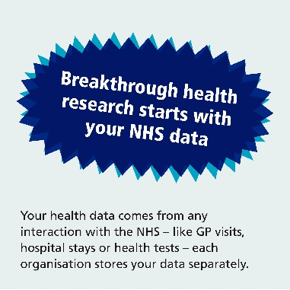
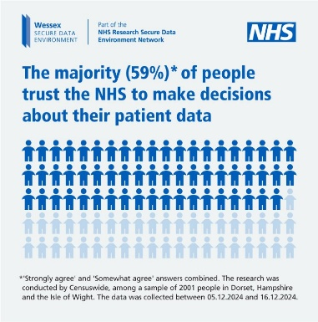
DATE & ACTION | PLATFORM | COPY | ASSET
Any time –Promote SDE explainer animation | Facebook, LinkedIn and Instagram | Discover how your NHS data powers life-saving medical research and better patient care. 🔬🩺 Your data can pave the way for breakthroughs and make a real difference to people’s lives by helping new treatments and medicines be developed💊💉🧬 Learn more and have your say today WessexSDE.nhs.uk/have-your-say – led by @UHSFT #ImprovingTomorrowsHealth #datasaveslives #healthdata #WessexSDE | Download MP4
 | X (nee Twitter) and Bluesky | Discover how your data supports life-saving research and better patient care.🩺 Learn more and have your say today wessexsde.nhs.uk/have-your-say – led by @UHSFT #ImprovingTomorrowsHealth #datasaveslives #healthdata #WessexSDE
Any time – Promote our polling statistics | Facebook, LinkedIn and Instagram | We're supporting the #ImprovingTomorrowsHealth campaign. It's a chance for everyone across Wessex to have their say on using NHS patient data for research. 🔬 🧪 🧫 Share how you feel about the NHS making decisions on your data today at WessexSDE.nhs.uk/have-your-say – led by UHSFT #datasaveslives #healthdata #WessexSDE | Download JPG
 | X (nee Twitter) and Bluesky | We're supporting the #ImprovingTomorrowsHealth campaign – it's a chance for you to have your say on using NHS data for research: www.WessexSDE.nhs.uk led by @UHSFT 🔬 🧪 🧫 #datasaveslives #healthdata #WessexSDE
please @ UNIVERSITY HOSPITAL SOUTHAMPTON: @uhsft (Facebook & Instagram)
please @ UNIVERSITY HOSPITAL SOUTHAMPTON: @uhsft (Facebook & Instagram)

Slide 8
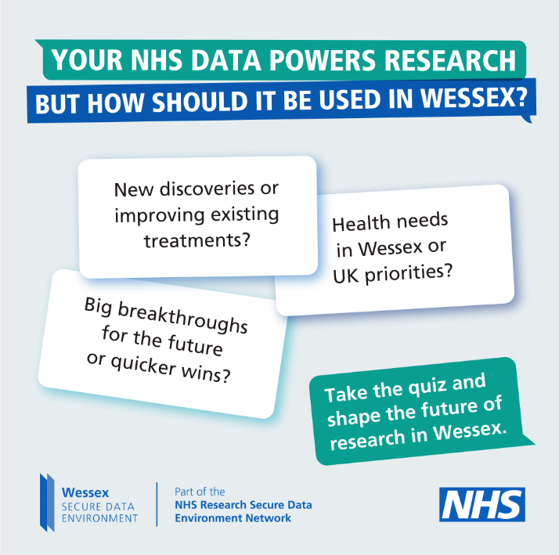
DATE & ACTION | PLATFORM | COPY | ASSET
Any time – Take the quiz and have their say | Facebook, LinkedIn and Instagram | How much do you know about how the NHS uses your data for research? 🔬 🧪 🧫 All health and care research starts with an idea. Finding out if that idea works and making new discoveries all comes down to data. Using NHS data, the UK led the global fight against Covid-19. Now the NHS wants to use it to address long-term issues like cancer, dementia, and mental health here in Wessex. 💊💉🧬 Take the #ImprovingTomorrowsHealth quiz and find out more: wsde.typeform.com/WessexSDE #datasaveslives #healthdata #WessexSDE | Download JPG
 | X (nee Twitter) and Bluesky | How much do you know about how the NHS uses your data for research? 🔬 🧪 🧫 Take the Improving Tomorrow's Health quiz and find out: wsde.typeform.com/WessexSDE #ImprovingTomorrowsHealth #datasaveslives #healthdata #WessexSDE
Any time – Visit the website | Facebook, LinkedIn and Instagram | Have you had your say about how we use NHS data for research? ​🔬 🧪 🧫 What matters most to you about how your data is used? What kind of research projects should be the priority? 🤔 Join the conversation now and help improve tomorrow’s health today: WessexSDE.nhs.uk/have-your-say led by @UHSFT #ImprovingTomorrowsHealth #datasaveslives #healthdata #WessexSDE | Download JPG
 | X (nee Twitter) and Bluesky | Have you had your say about how we use NHS data for research? ​🔬 🧪 🧫 Join the conversation now and help improve tomorrow’s health today: WessexSDE.nhs.uk/have-your-say led by @UHSFT #ImprovingTomorrowsHealth #datasaveslives #healthdata #WessexSDE
please @ UNIVERSITY HOSPITAL SOUTHAMPTON: @uhsft (Facebook & Instagram)

Slide 9
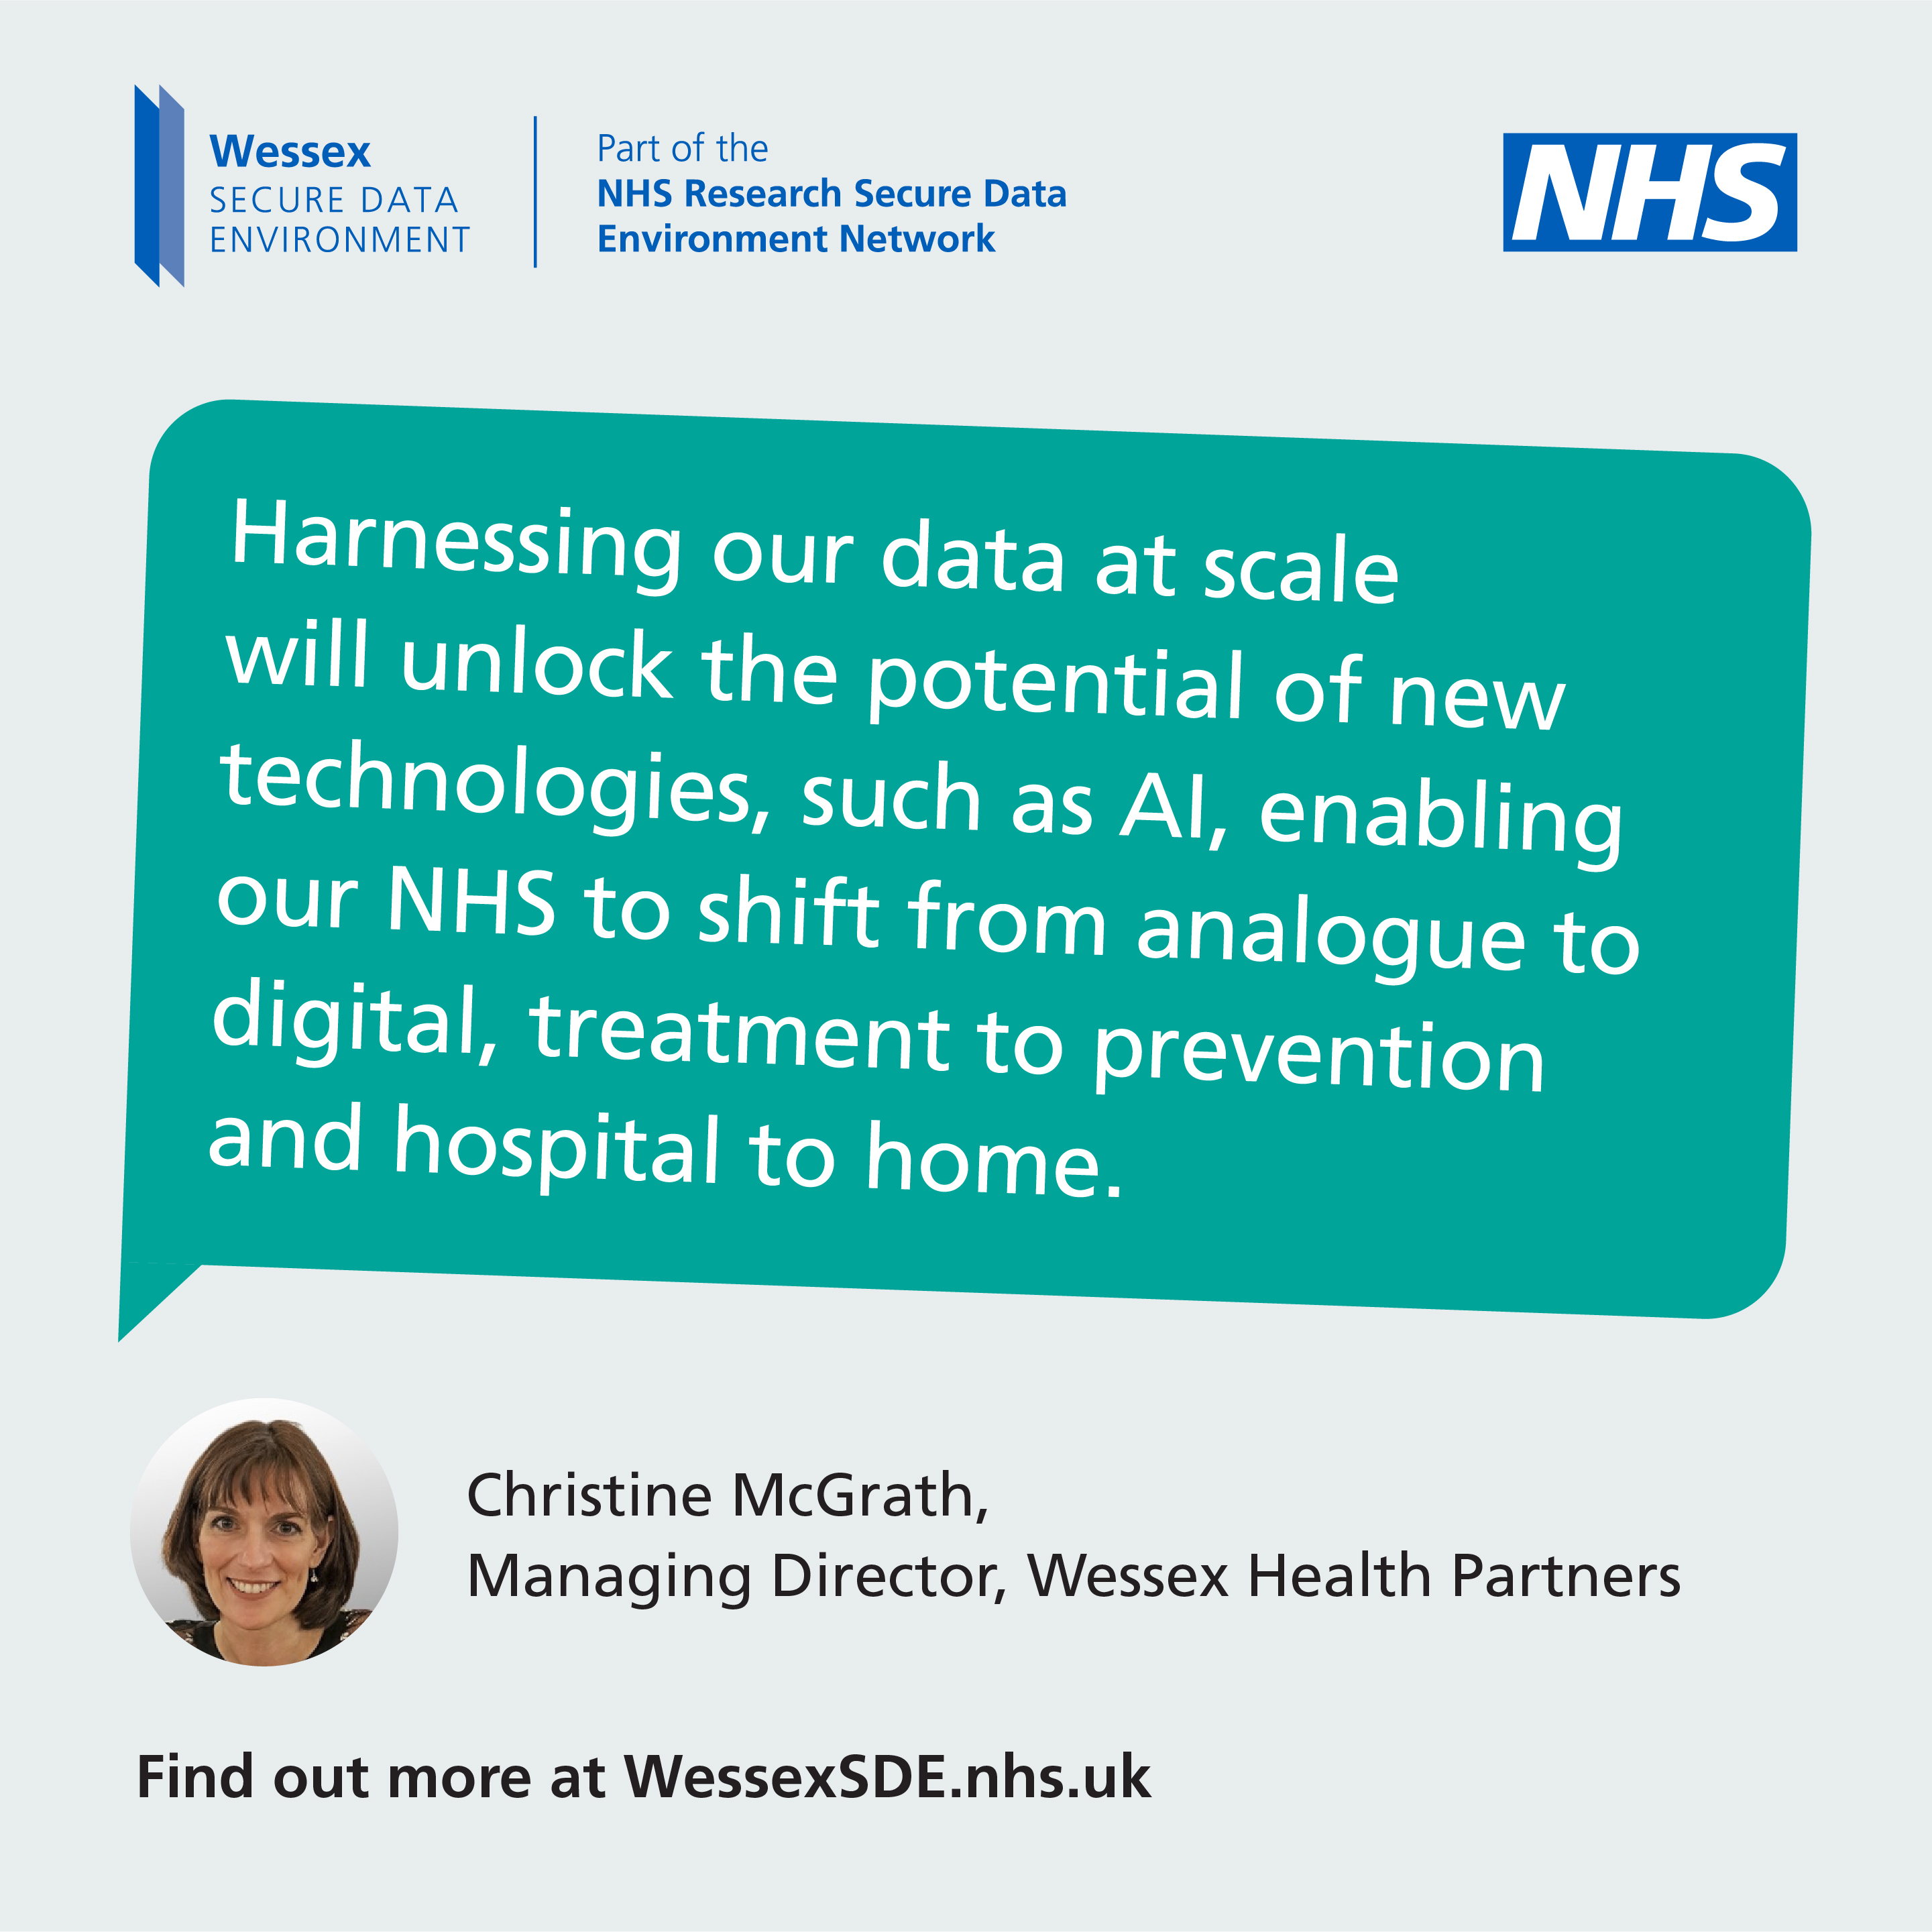
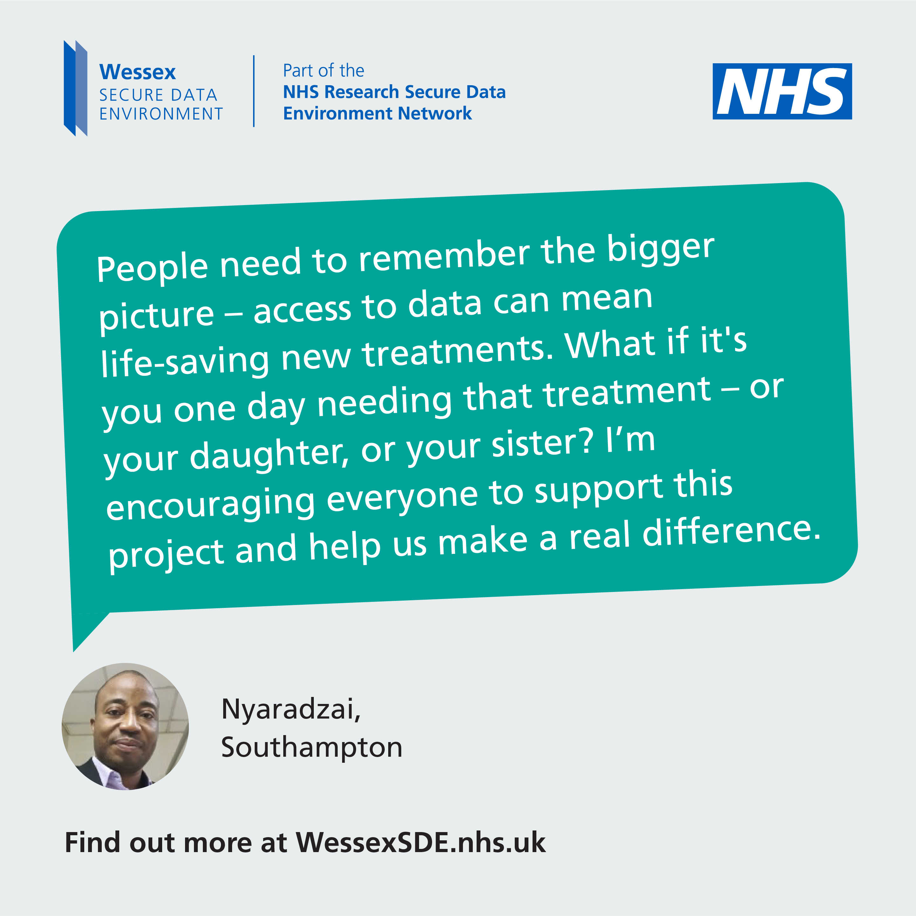
DATE & ACTION | PLATFORM | COPY | ASSET
Any time – How data transforms NHS care | Facebook, LinkedIn and Instagram | Here’s why Christine McGrath from Wessex Health Partners thinks data holds the key to improving the NHS Discover how your NHS data can transform patient care. 🔬🩺 Learn more and have your say today www.WessexSDE.nhs.uk – led by @UHSFT #ImprovingTomorrowsHealth #datasaveslives #healthdata #WessexSDE | Download JPG
 | X (nee Twitter) and Bluesky | @WHPChristineMcG from @Wessexhp thinks data holds the key to improving the NHS. Learn more and have your say today www.WessexSDE.nhs.uk #ImprovingTomorrowsHealth #datasaveslives #healthdata #WessexSDE
Week 1 – w/c 10 February –Who could your NHS data help? | Facebook, LinkedIn and Instagram | Who could your #NHSdata help? Nyaradzai shares why access to NHS data can make such a big difference to those you love. Find out how you can get involved at www.WessexSDE.nhs.uk – led by @UHSFT #ImprovingTomorrowsHealth #datasaveslives #healthdata #WessexSDE | Download JPG
 | X (nee Twitter) and Bluesky | Who could your #NHSdata help? Find out more at www.WessexSDE.nhs.uk led by @UHSFT #ImprovingTomorrowsHealth #datasaveslives #healthdata #WessexSDE
please @ UNIVERSITY HOSPITAL SOUTHAMPTON: @uhsft (Facebook & Instagram)
please @ UNIVERSITY HOSPITAL SOUTHAMPTON: @uhsft (Facebook & Instagram)

Slide 10
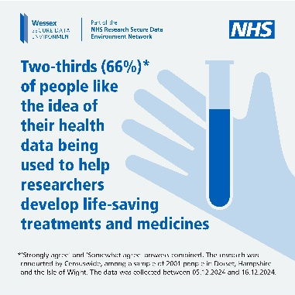
DATE & ACTION | PLATFORM | COPY | ASSET
Week 1 – w/c 10 February –Polling on what people think about using NHS data for research | Facebook, LinkedIn and Instagram | People across Wessex like the idea of their data being used for life-changing research. 🔬 🧪 🧫 Linking NHS patients’ data helps researchers ask bigger questions and find ways to do things differently – from improving emergency care to developing personalised cancer treatments. 🩻💉 What do you think about how we should use NHS data for research? Share your views today: WessexSDE.nhs.uk/have-your-say led by UHSFT #ImprovingTomorrowsHealth #datasaveslives #healthdata #WessexSDE | Download JPG
 | X (nee Twitter) and Bluesky | People across Wessex like the idea of their data being used for life-changing research. 🔬 🧪 🧫Share your views: WessexSDE.nhs.uk/have-your-say led by @UHSFT #ImprovingTomorrowsHealth #datasaveslives #healthdata #WessexSDE
Week 1 – w/c 24 February –Research into cancer vaccines | Facebook, LinkedIn and Instagram | This month is National Cancer Prevention Month so Dr Victoria Goss from @SouthamptonCTU is talking about how she’s using NHS data to further groundbreaking research into personalised cancer vaccines. 💉🔬 #ImprovingTomorrowsHealth #datasaveslives #healthdata #WessexSDE | Download MP4
 | X (nee Twitter) and Bluesky | This month is National Cancer Prevention Month so Dr Victoria Goss from @SouthamptonCTU is talking about how she’s using NHS data to further groundbreaking research #ImprovingTomorrowsHealth #datasaveslives #healthdata #WessexSDE
please @ UNIVERSITY HOSPITAL SOUTHAMPTON: @uhsft (Facebook & Instagram)
please @ Southampton clinical trials unit: @southamptonCTU (Facebook & INSTAGRAM) OR @Southampton clinical trials unit (LinkedIn)

Slide 11
DATE & ACTION | PLATFORM | COPY | ASSET
Week 2 – w/c 3 March – Highlighting the role of public involvement | Facebook, LinkedIn and Instagram | Fareham mum Sandra has been helping the Wessex Secure Data Environment as a critical friend. As a member of the local community, her role is vital to ensure people’s views are taken into account as it develops. She shares why she supports using NHS data for research. 🔬 🧪 🧫 #ImprovingTomorrowsHealth #datasaveslives #healthdata #WessexSDE | Download JPG
 | X (nee Twitter) and Bluesky | Fareham mum Sandra has been helping the Wessex Secure Data Environment as a critical friend, here’s why she supports using NHS data for research, 🔬 🧪 🧫 #ImprovingTomorrowsHealth #datasaveslives #healthdata #Wessex SDE
Week 2 – w/c 3 March – How your NHS data speeds up medical breakthroughs | Facebook, LinkedIn and Instagram | Dr Paul Johnson, Chief Medical Officer, @NHSDorset explains how NHS data can speed up medical breakthroughs 💊💉🧬 Everyone across Wessex is being encouraged to share their views on using NHS data for research. 🔬 🧪 🧫 #ImprovingTomorrowsHealth #datasaveslives #healthdata #WessexSDE | Download MP4
 | X (nee Twitter) and Bluesky | Dr Paul Johnson, Chief Medical Officer, @NHSDorset explains how NHS data can speed up medical breakthroughs 💊💉🧬 #ImprovingTomorrowsHealth #datasaveslives #healthdata #WessexSDE
please @ NHS DORSET: @NHSDORSET (Facebook & INSTAGRAM) OR @NHS DORSET (LinkedIn)

Slide 12
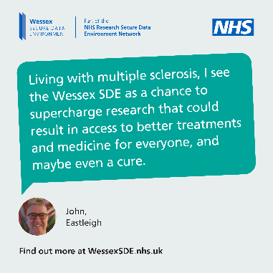
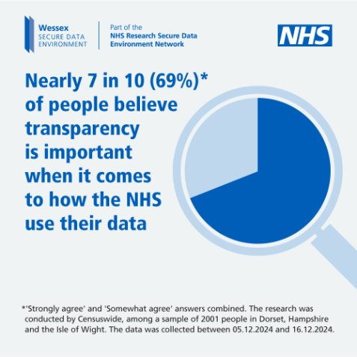
DATE & ACTION | PLATFORM | COPY | ASSET
Week 2 - w/c 3 March – John tells his story | Facebook, LinkedIn and Instagram | Eastleigh resident John has been helping the Wessex Secure Data Environment as a critical friend. As someone living with #MultipleSclerosis, John has had to take early medical retirement but he is determined to play a part in the future. He shares why using data for research is so important. 🔬 🧪 🧫 #ImprovingTomorrowsHealth #datasaveslives #healthdata #WessexSDE | Download JPG
 | X (nee Twitter) and Bluesky | Eastleigh resident John has been helping the Wessex Secure Data Environment as a critical friend, he shares why using data for research is so important. 🔬 🧪 🧫 #ImprovingTomorrowsHealth #datasaveslives #healthdata #Wessex SDE
Week 3 – w/c 10 March – Polling shows NHS transparency is vital | Facebook, LinkedIn and Instagram | What matters most to you about how the NHS handles your data? 🤔 In the Wessex Secure Data Environment, researchers will not see confidential personal details like your name, address, or NHS number. This information is removed or disguised before access is given. Researchers only see the data they need and only in a secure environment fully controlled by the NHS. Does this work for you? Share your thoughts today at www.WessexSDE.nhs.uk led by @UHSFT #ImprovingTomorrowsHealth #datasaveslives #healthdata #Wessex SDE | Download JPG
 | X (nee Twitter) and Bluesky | What matters most to you about how the NHS handles your data? 🤔 Share your thoughts today at WessexSDE.nhs.uk/have-your-say led by @UHSFT #ImprovingTomorrowsHealth #datasaveslives #healthdata #Wessex SDE
please @ UNIVERSITY HOSPITAL SOUTHAMPTON: @uhsft (Facebook & Instagram)

Slide 13
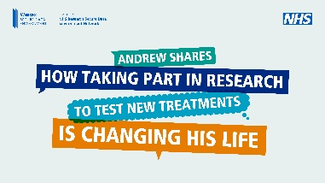
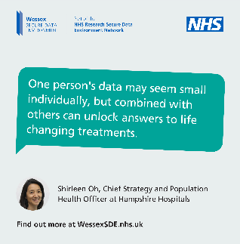
DATE & ACTION | PLATFORM | COPY | ASSET
Week 3 – w/c 10 March – Andrew shares his story | Facebook, LinkedIn and Instagram | Winchester resident Andrew lives with a long-term lung condition. 🫁 #IPF #lungdisease Hear him talk about why he has got involved in NHS research and find out how you could get involved today. #ImprovingTomorrowsHealth #datasaveslives #healthdata #WessexSDE | Download MP4
 | X (nee Twitter) and Bluesky | Hear from Winchester resident Andrew on why he has got involved in NHS research and find out how you could get involved today. #ImprovingTomorrowsHealth #datasaveslives #healthdata #WessexSDE
Week 3 – w/c 10 March – The power of sharing data | Facebook, LinkedIn and Instagram | Shirleen Oh from @HHFTnhs talks about the power of #healthdata. Sharing your data can pave the way for important breakthroughs that could make a real difference to people’s lives by helping new treatments and medicines be developed💊💉🧬 Find out more at WessexSDE.nhs.uk/have-your-say #ImprovingTomorrowsHealth #datasaveslives #WessexSDE | Download JPG Download MP4
 | X (nee Twitter) and Bluesky | Shirleen Oh from @HHFTnhs talks about the power of #healthdata. Find out more at WessexSDE.nhs.uk/have-your-say #ImprovingTomorrowsHealth #datasaveslives #WessexSDE
please @ Hampshire Hospitals: @hhftnhs (Facebook), @Hampshire Hospitals nhs foundation trust (LinkedIn) or @hampshirehospitals (Instagram)

Slide 14
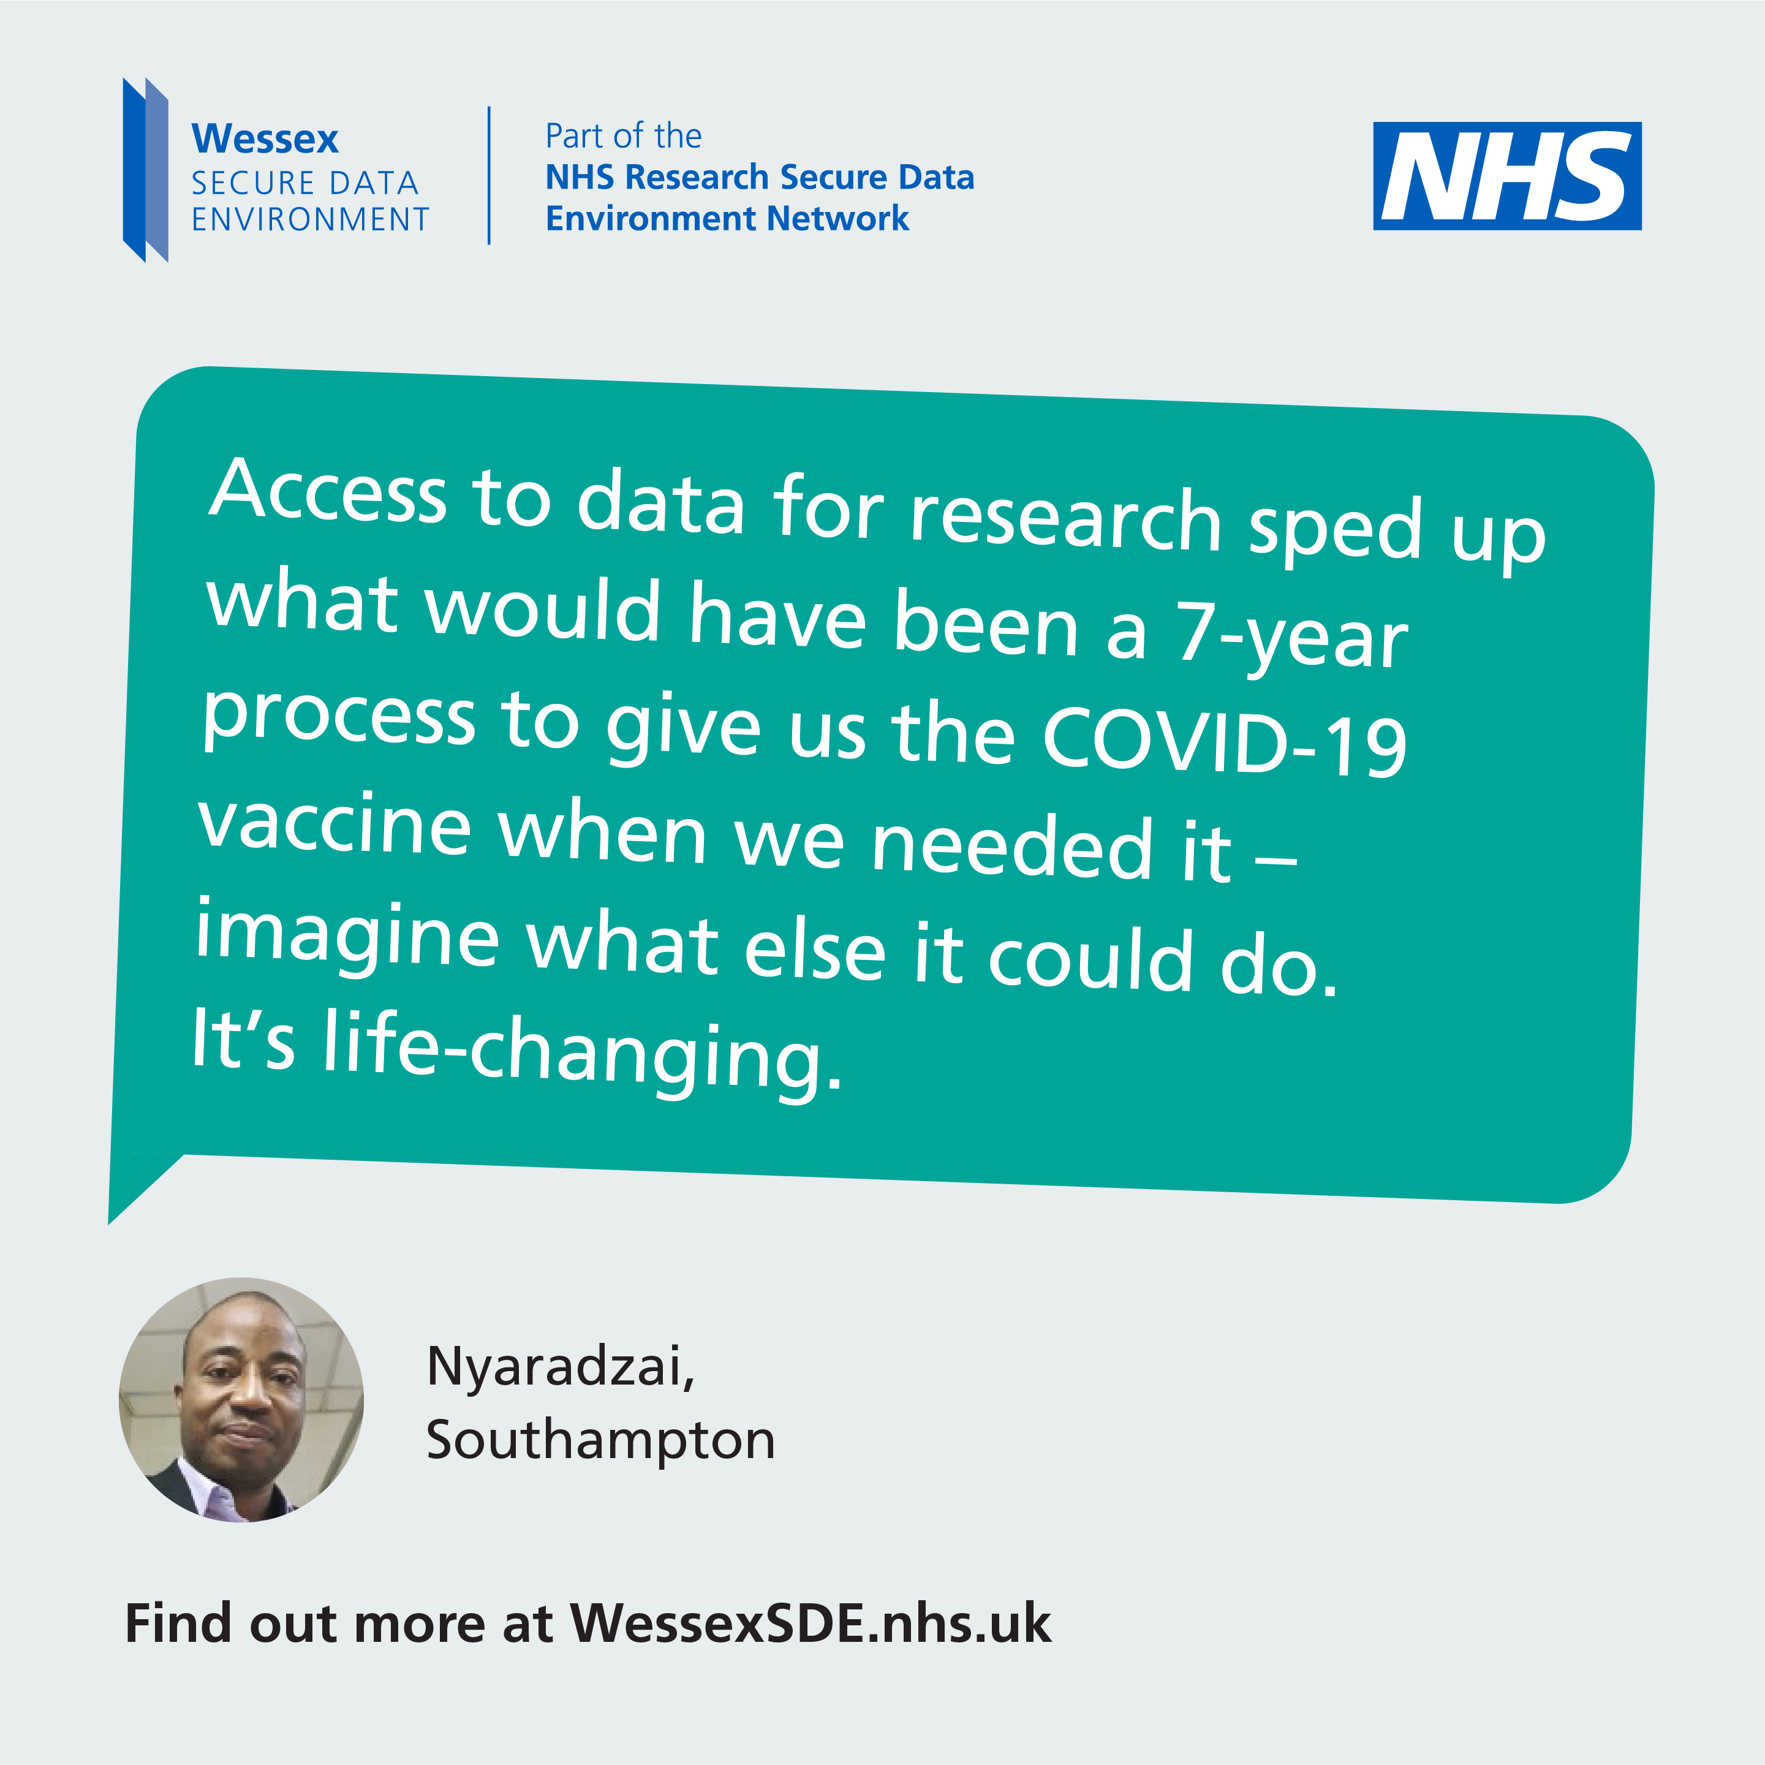
DATE & ACTION | PLATFORM | COPY | ASSET
Week 4 – w/c 17 March – Nyaradzai gives his view of why the NHS should build the SDE | Facebook, LinkedIn and Instagram | Southampton resident Nyaradzai talks about how data can fast track breakthroughs like it did with the COVID-19 vaccine. 💉 The Wessex Secure Data Environment, led by @UHSFT wants to use your NHS data to address long-term issues like cancer, dementia, and mental health here in Wessex. 💊🧬 #ImprovingTomorrowsHealth #datasaveslives #healthdata #WessexSDE | Download JPG Download MP4
 | X (nee Twitter) and Bluesky | Southampton resident Nyaradzai talks about data can fast track breakthroughs like it did with the COVID-19 vaccine. 💉 #ImprovingTomorrowsHealth #datasaveslives #healthdata #WessexSDE
please @ UNIVERSITY HOSPITAL SOUTHAMPTON: @uhsft (Facebook & Instagram)

Slide 15
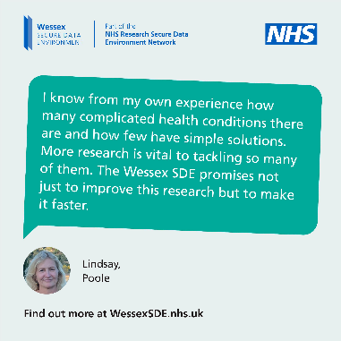
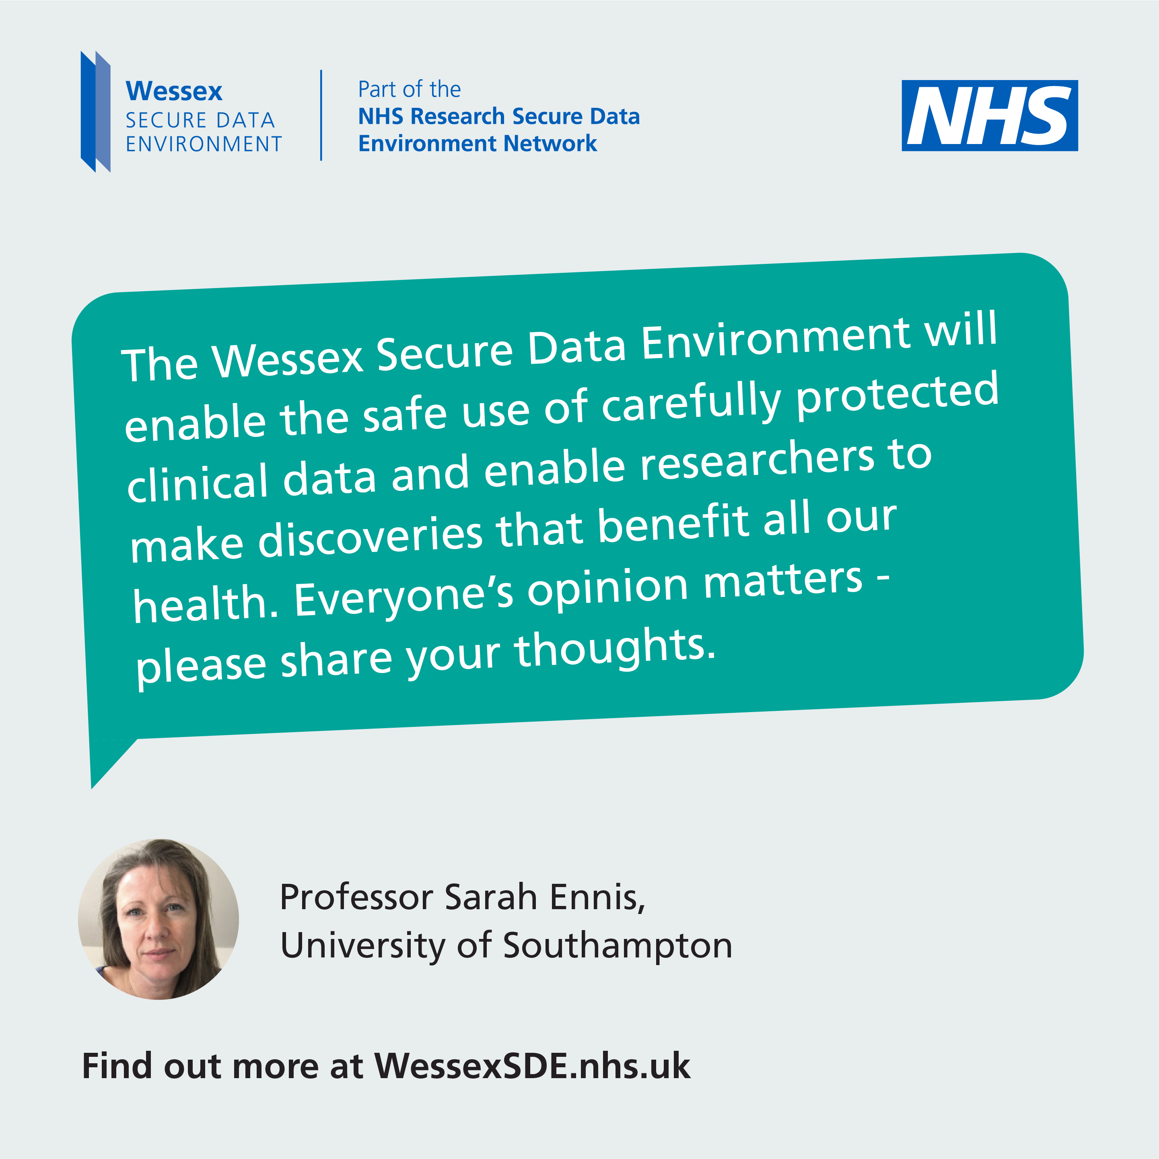
DATE & ACTION | PLATFORM | COPY | ASSET
Week 4 - w/c 17 March – Why we need more and faster research | Facebook, LinkedIn and Instagram | Poole resident Lindsay who volunteered as a critical friend to the Wessex Secure Data Environment led by @USHFT explains why she got involved. As a member of the local community, her role is vital to ensure people’s views are taken into account as it develops. #ImprovingTomorrowsHealth #datasaveslives #healthdata #WessexSDE | Download JPG
 | X (nee Twitter) and Bluesky | Poole resident Lindsay who volunteered as a critical friend to the Wessex Secure Data Environment led by @UHSFT explains why she got involved. #ImprovingTomorrowsHealth #datasaveslives #healthdata #WessexSDE
Week 4 – w/c 17 March – Spotlight on personalised cancer treatments | Facebook, LinkedIn and Instagram | Professor Sarah Ennis @UHSFTresearch encourages everyone to have their say about using NHS data for research. The #ImprovingTomorrowsHealth campaign is a chance for everyone across Wessex to have their say on using NHS data for research. 🔬 🧪 🧫 Share your thoughts today: WessexSDE.nhs.uk/have-your-say #datasaveslives #healthdata #WessexSDE | Download JPG
 | X (nee Twitter) and Bluesky | Professor Sarah Ennis @UHSFTresearch encourages everyone to have their say about using NHS data for research: WessexSDE.nhs.uk/have-your-say #ImprovingTomorrowsHealth #datasaveslives #healthdata #WessexSDE
please @ UNIVERSITY HOSPITAL SOUTHAMPTON: @uhsft (Facebook & Instagram)
please @ UNIVERSITY HOSPITAL SOUTHAMPTON research: @uhsftRESEARCH (Facebook & instagram) or @HEALTHRESEARCHSOUTHAMPTON (LINKEDIN)

Slide 16
Newsletter copy & listicles
You can use this copy in any newsletters you send out or on your website

Slide 17
Newsletter copy: Long version (214 words)
It’s time to have your say on the use of NHS data for research
University Hospital Southampton is leading the development of the Wessex Secure Data Environment (Wessex SDE), a new online platform which will use NHS data to improve health outcomes and save lives.
Imagine life-saving treatments, quicker diagnoses, and breakthroughs in managing long-term conditions – all powered by NHS data. The Wessex SDE will make this a reality.
Built to the highest standards for safety and security of NHS data, the Wessex SDE will enable large amounts of de-identified NHS patient data to be safely stored, linked together and made accessible to researchers to improve services and treatments.
By linking different types of data, researchers can ask bigger questions and gain new insights. This will drive discovery of new treatments and make the health and care system more efficient, effective and safe.
The team wants to hear from people across Wessex and is inviting everyone to join a public conversation on Improving Tomorrow’s Health.
What matters most to you about how your NHS data is used? What kind of research projects should the Wessex SDE support with your de-identified data? How involved do you want to be in decisions? To share your views and be part of the conversation, go to WessexSDE.nhs.uk/have-your-say today.

Slide 18
Newsletter copy: Short version (92 words)
Have your say on the use of NHS data for research
The Wessex Secure Data Environment (Wessex SDE) is an NHS platform that safely stores and links patient data to support groundbreaking health and care research. Imagine faster diagnoses, life-saving treatments, and innovative healthcare all powered by this data.
The team, led by University Hospital Southampton, want to know what people across Wessex think about the project and are inviting everyone to share their views as part of a public conversation on Improving Tomorrow’s Health. Go to WessexSDE.nhs.uk/have-your-say today to take part.

Slide 19
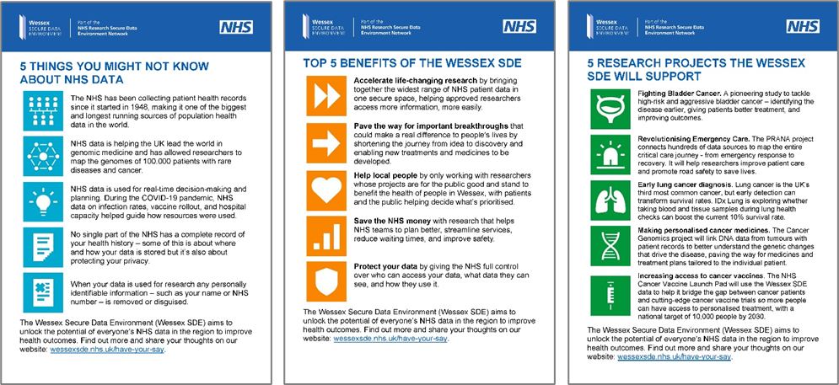
Listicles
The listicles in this toolkit are designed to simplify key messages about NHS data and the Wessex Secure Data Environment (SDE).
Each listicle highlights essential insights, benefits, or real-world research examples, making complex topics accessible and engaging.
Download a ZIP file of all the listicles as images, MS Word document, and PDF: Download ZIP
Cut and paste copy from the pages the follow.

Slide 20
5 things you might not know about NHS data
The NHS has been collecting patient health records since it started in 1948, making it one of the biggest and longest running sources of population health data in the world.
NHS data is helping the UK lead the world in genomic medicine and has allowed researchers to map the genomes of 100,000 patients with rare diseases and cancer.
NHS data is used for real-time decision-making and planning. During the COVID-19 pandemic, NHS data on infection rates, vaccine rollout, and hospital capacity helped guide how resources were used.
No single part of the NHS has a complete record of your health history – some of this is about where and how your data is stored but it’s also about protecting your privacy.
When your data is used for research any personally identifiable information such as your name or NHS number is removed or disguised.
The Wessex Secure Data Environment (Wessex SDE) aims to unlock the potential of everyone’s NHS data in the region to improve health outcomes. Find out more and share your thoughts on our website: https://wessexsde.nhs.uk/.

Slide 21
Top 5 benefits of the Wessex SDE
The Wessex SDE will:
Accelerate life-changing research by bringing together the widest range of NHS patient data in one secure space, helping approved researchers access more information, more easily.
Pave the way for important breakthroughs that could make a real difference to people’s lives by shortening the journey from idea to discovery and enabling new treatments and medicines to be developed.
Help local people by only working with researchers whose projects are for the public good and stand to benefit the health of people in Wessex, with patients and the public helping decide what’s prioritised.
Save the NHS money with research that helps NHS teams to plan better, streamline services, reduce waiting times, and improve safety.
Protect your data by giving the NHS full control over who can access your data, what data they can see, and how they use it.
The Wessex Secure Data Environment (Wessex SDE) aims to unlock the potential of everyone’s NHS data in the region to improve health outcomes. Find out more and share your thoughts on our website: WessexSDE.nhs.uk/have-your-say.

Slide 22
5 research projects the Wessex SDE will support
Researchers will use the Wessex SDE to access patient data safely, quickly, and easily to answer a huge variety of questions, discover life-changing new treatments and medicines, and make the health and social care system more efficient, effective and safe. Five research projects the SDE will help:
Fighting Bladder Cancer. A pioneering study to tackle high-risk and aggressive bladder cancer – identifying the disease earlier, giving patients better treatment, and improving outcomes.
Revolutionising Emergency Care. The PRANA project connects hundreds of data sources to map the entire critical care journey - from emergency response to recovery. It will help researchers improve patient care and promote road safety to save lives..
Early lung cancer diagnosis. Lung cancer is the UK’s third most common cancer, but early detection can transform survival rates. IDx Lung is exploring whether taking blood and tissue samples during lung health checks can boost the current 10% survival rate.
Making personalised cancer medicines. The Cancer Genomics project will link DNA data from tumours with patient records to better understand the genetic changes that drive the disease, paving the way for medicines and treatment plans tailored to the individual patient.
Increasing access to cancer vaccines. The NHS Cancer Vaccine Launch Pad will use the Wessex SDE data to help it bridge the gap between cancer patients and cutting-edge cancer vaccine trials so more people can have access to personalised treatment, with a national target of 10,000 people by 2030.
The Wessex Secure Data Environment (Wessex SDE) aims to unlock the potential of everyone’s NHS data in the region to improve health outcomes. Find out more and share your thoughts on our website: WessexSDE.nhs.uk/have-your-say.

Slide 23
Onsite collateral
This section includes materials you can use on-location – posters to put up or leaflets to hand out at events or leave in venues. You can also use them on your websites.

Slide 24
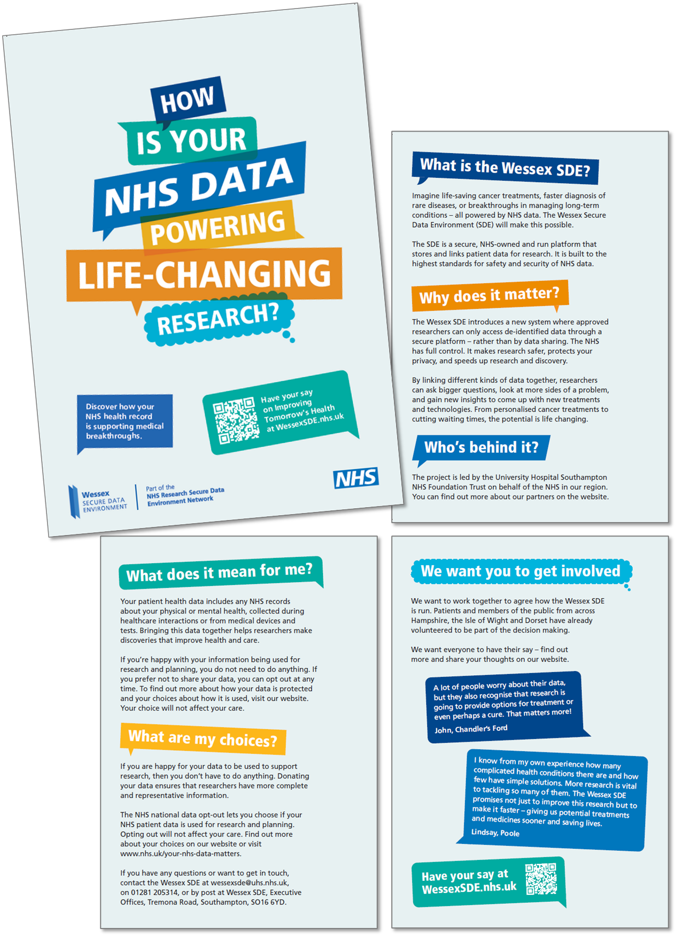
Posters and leaflets
Promote the campaign with our eye-catching posters, available in A4, A3, and A2 sizes. Each poster features a QR code linking directly to the campaign website.
Download PDF
To request copies, simply contact the project team with the quantities and sizes you need.
Our A5 leaflet provides a clear and concise introduction to the Wessex Secure Data Environment, highlighting how data-driven research supports health improvements. It explains patient choice, including opt-out options, and outlines ways to get involved. Perfect for sharing at events or in community spaces.
Download PDF
Contact us to order the copies you need.

Slide 25
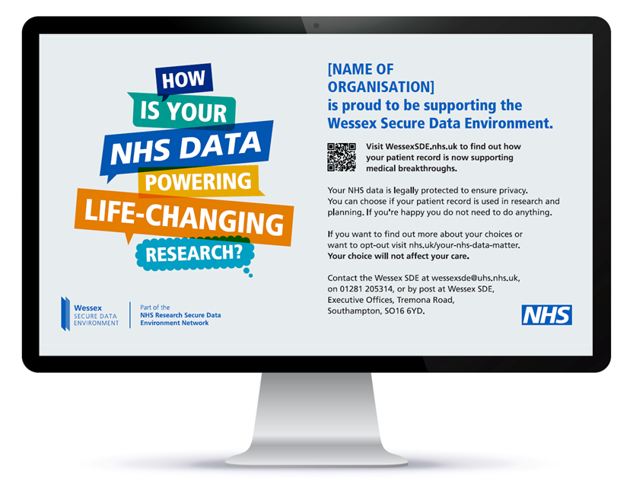
Digital screens content
Put the campaign on your digital screens using our scalable content. Get in touch for a version tailored to your organisation – or download a generic version using the link below:
Download ZIP

Slide 26
Speakers for your events
Talk to us about having someone come and speak at events you are running.

Slide 27
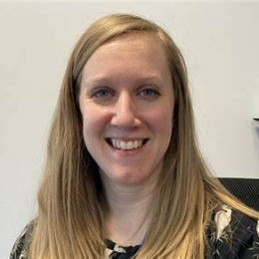
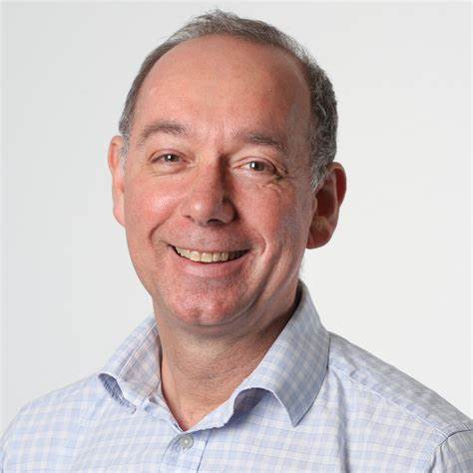
Speakers
We’d love to come and speak about the Wessex SDE any upcoming events. We can provide access to a range of speakers.
To make a request, please contact us using the details at the end of this document.
The campaign will run until the mid-April 2025 and we’d be happy to attend any events before then, where possible.
Researchers excited about the impact of the Wessex SDE on their work, like Professor Sarah Ennis and Dr Victoria Goss who are working on cancer genomics and vaccines, or Dr Phil Hyde who is doing research into improving emergency care.
Our Digital Critical Friends – members of the Wessex public who’ve volunteered to act as a sounding board as the project develops.
Project leads like Professor Chris Kipps and Mark Heffernan who can talk about how the Wessex SDE will work and answer any questions on how we ensure we navigate the use of data safely and effectively to drive real improvements for patients across the region.

Slide 28
Additional content
You can use this content on your website or social channels.

Slide 29
Promote the quiz!
We've created a quiz where your audiences can share their thoughts on the values, rules, and priorities that will guide the Wessex SDE.
By sharing this quiz, you’ll help ensure the platform reflects the needs of all our communities.
You can download the social media asset here:
Download JPG
SOCIAL POST COPY
The NHS in Wessex is building the Wessex Secure Data Environment (SDE) to keep NHS data safe while powering life-saving research. 🏥✨ Take a quick quiz to share your views on how this platform should work. Your views will shape the rules, values, and priorities for how it is run. 🌟 Your voice matters! 👉 Click here to take part: wsde.typeform.com/WessexSDE #datasaveslives #WessexSDE #HealthData #ImprovingTomorrowsHealth

Slide 30
Animation: How does the SDE work?
Our animation explains how the SDE enables secure, ethical use of data to improve treatments and the NHS. Share it with one of the posts below.
Download MP4
💡Did you know your NHS patient data could help save lives? The Wessex Secure Data Environment makes it possible to access data safely for life-saving research. 🔗 Learn more and have your say at wessexsde.nhs.uk/have-your-say – led by @UHSFT #ImprovingTomorrowsHealth #datasaveslives #healthdata #WessexSDE | ⚡ Your NHS patient data is powering life-changing research. The Wessex SDE makes sure this happens in a way that people can trust – keeping your data safe and private. 🔗 Learn more and have your say at wessexsde.nhs.uk/have-your-say – led by @UHSFT #ImprovingTomorrowsHealth #datasaveslives #healthdata #WessexSDE

Slide 31
What others are saying: Our quotes bank
DOWNLOAD ZIP FILE
Download our quotes bank to find inspiring messages from doctors, researchers and public contributors about the Wessex SDE.
We have over 20 ready-made social media graphics you can use to drive action. Just click the link below to download a ZIP file of all the assets:
Download ZIP

Slide 32
Videos to inspire and start a discussion
Explore our video library to hear researchers explain how NHS patient data powers groundbreaking studies, discover how the Wessex SDE accelerates research, and see public contributors share their reflections. Download or share these videos anytime to inspire others.
Click the link below to go to the Toolkit page on our website, where you van view and download the videos you want:
Visit Video Library
VISIT VIDEO LIBRARY

Slide 33
Get in touch
If you have any questions or want to get in touch. Give us a call or an email and we will do our best to help!
Thank you for your time and support!
MEDIA & CAMPAIGN INQUIRIES
Please contact:
Fiona Beveridge E: fiona.beveridge@opyn.consulting M: 07729 613 997
Ralph Scott E: ralph.scott@opyn.consulting M: 07951 572065
PUBLIC INQUIRIES
E: wessexsde@uhs.nhs.uk
T: 02381 205314
Wessex SDE Executive Offices Tremona Road Southampton SO16 6YD.

