Slide 1
Improving Tomorrow's Health Communications Toolkit – Part 2
Driving public conversation on the use of NHS patient data for research (March 2025)

Slide 2
Introduction to the second toolkit
Welcome to the second instalment of the Improving Tomorrow’s Health Toolkit. We have updated the toolkit with fresh content for your channels. If you have supported the campaign already, thank you so much! If you are new to this, read on for more information on the campaign.
The Wessex Secure Data Environment (Wessex SDE) is an online platform where large amounts of NHS patient data will be safely stored, linked together, and made accessible to researchers to improve services and treatments. The project is being led by University Hospital Southampton with input from all parts of the local NHS.
We genuinely want to know what people across Wessex think about the project and need your help to do this.
The idea of the Wessex SDE is to help researchers to develop life-saving treatments and medicines and improve the way the NHS works for patients, but we need to do this in a way that everyone feels comfortable with.
That’s why we’re running the Improving Tomorrow’s Health campaign, asking people to let us know their thoughts, questions and concerns about using NHS data for research. We’ll then take this into account as we develop the project.
We need your help to share information about the campaign. We’ve already spoken to hundreds of people and engaged with local groups across Wessex but it’s critical we go further.
We’ve updated this toolkit with additional content to help you spread the word. It includes everything you need—social media posts, newsletter copy, and creative assets—to support the campaign on your own channels and with your networks. Your help is crucial to ensure everyone in Wessex has the opportunity to have their say on this important initiative.
The initial campaign will end on Friday 18th April and we’d be grateful for any content-sharing you can do up to that point.
If you have any questions or require additional materials, please don’t hesitate to contact the team at wessexsde@uhs.nhs.uk. Our full contact details are at the end of this document.
Thank you for your support!

Slide 3
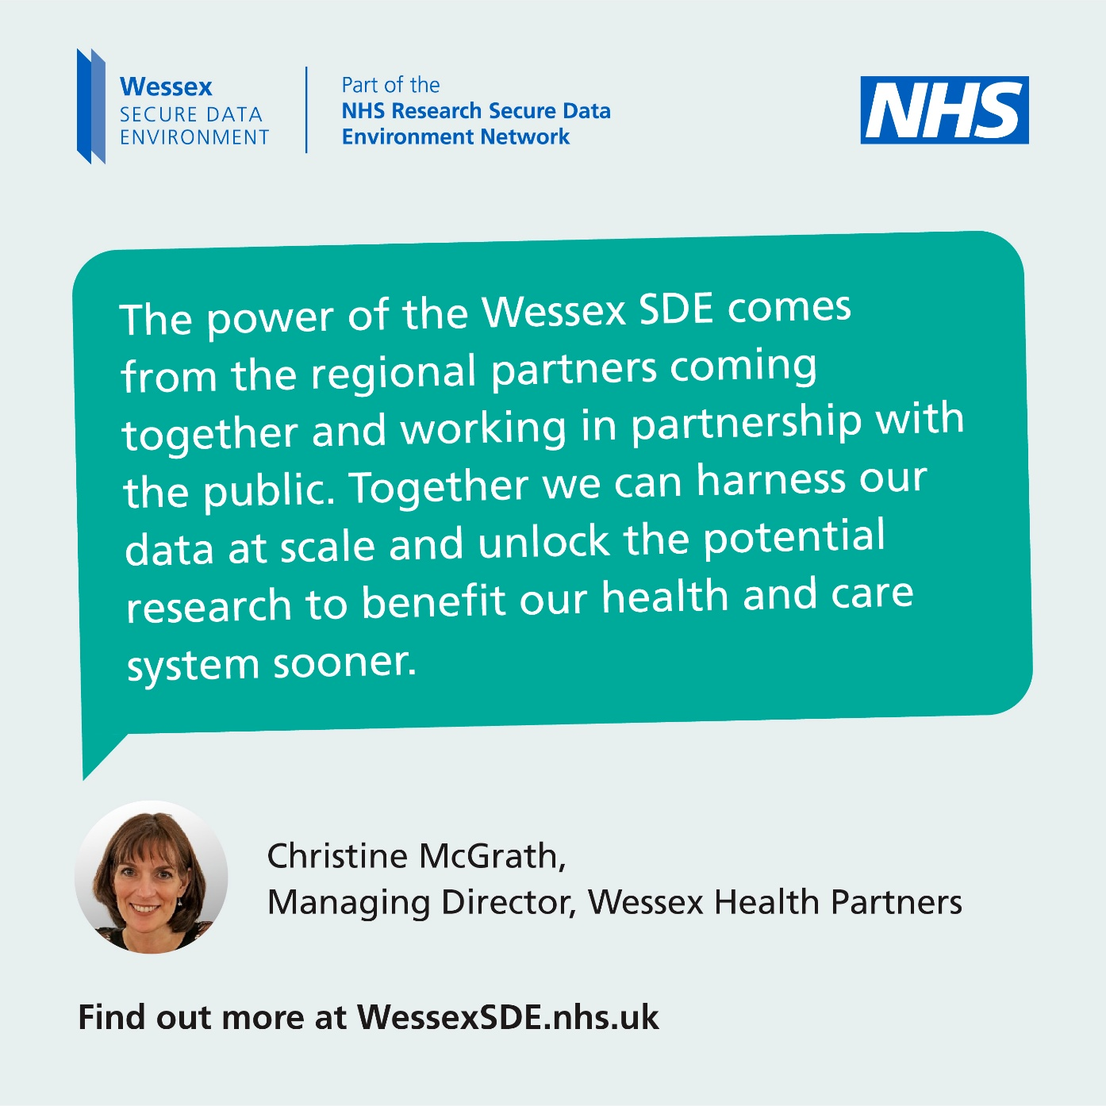
Contents
Top tips for using this toolkit
Social content
Newsletter copy and listicles
Onsite collateral
Speakers for your events
Additional content
Contact us

Slide 4
Top tips for using this toolkit
Use what works for you
You can pick and choose which types of content work best whether it's requesting leaflets or using social posts.
Invite debate
If you're on social media, use our poll and social content to spark debate. Tag partners and use campaign hashtags to amplify your reach.
Stick to the messages
Please use the provided content as it is to keep the messaging consistent and accurate. Most importantly, ensure there is a clear call to action – we want people to go to the website and share their thoughts: wessexsde.nhs.uk/have-your-say/
We can answer any questions
If you receive queries about the SDE, we’ve created a helpful FAQ on our website. Or if you’d prefer, simply refer them to the campaign team - we’re here to help!
Track and share engagement
Monitor how your audience interacts with the campaign (e.g., likes, shares, and comments). We would greatly appreciate it if you could share your engagement insights with the campaign team.

Slide 5
Find the toolkit online
You can find all the toolkit materials online, including PDF and PowerPoint versions of this document.
Visit the toolkit.

Slide 6
Social content
This section features new content you can use at any point to show your support on social media and a new content calendar designed for the last 4 weeks of the campaign. Don’t worry if you can’t follow the suggested timeline, you can pick and choose what works for you.

Slide 7
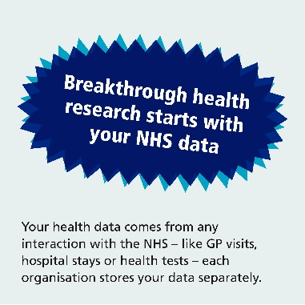
DATE & ACTION | PLATFORM | COPY | ASSET
Any time –Promote polling stats and SDE explainer animation | Facebook, LinkedIn and Instagram | Half of people in Dorset, Hampshire & the Isle of Wight would discourage others from opting out of NHS data sharing – would you? Find out how your de-identified NHS data could be used to power life-saving medical research and better patient care. 🔬🩺 Learn more and have your say today WessexSDE.nhs.uk/have-your-say – led by @UHSFT #ImprovingTomorrowsHealth #datasaveslives #healthdata #WessexSDE #PoweredbyNHSData | Download MP4
 | X (nee Twitter) and Bluesky | Half of people in Dorset, Hampshire & the Isle of Wight would discourage others from opting out of NHS data sharing – would you? Learn more and have your say today wessexsde.nhs.uk/have-your-say – led by @UHSFT #ImprovingTomorrowsHealth #datasaveslives #healthdata #WessexSDE #PoweredbyNHSData
Any time – Promote our polling statistics | Facebook, LinkedIn and Instagram | 59% of people in Dorset, Hampshire & the Isle of Wight believe the Wessex Secure Data Environment should prevent avoidable diseases and reduce demand on the NHS in the future rather than developing treatments for people who are already sick. 🧪 🧫 Share what you think the NHS priorities should be at WessexSDE.nhs.uk/have-your-say – led by @UHSFT #datasaveslives #healthdata #WessexSDE #PoweredbyNHSData | Download JPG
 | X (nee Twitter) and Bluesky | We're supporting the #ImprovingTomorrowsHealth campaign – it's a chance for you to have your say on using NHS data for research: www.WessexSDE.nhs.uk led by @UHSFT 🔬 🧪 🧫 #datasaveslives #healthdata #WessexSDE #PoweredbyNHSData
please @ UNIVERSITY HOSPITAL SOUTHAMPTON: @uhsft (Facebook & Instagram)
please @ UNIVERSITY HOSPITAL SOUTHAMPTON: @uhsft (Facebook & Instagram)

Slide 8
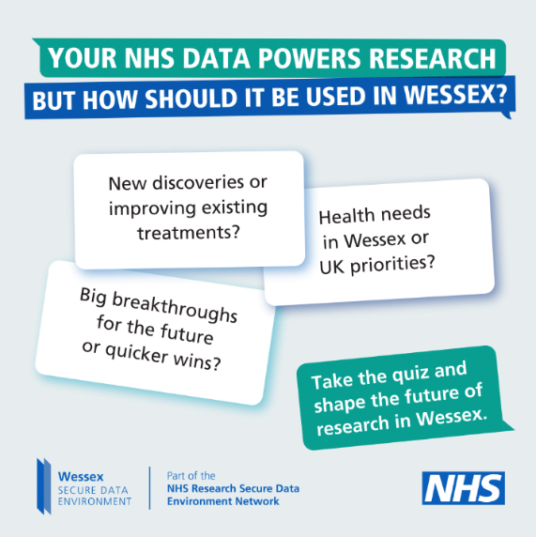
DATE & ACTION | PLATFORM | COPY | ASSET
Any time – Take the quiz and have their say | Facebook, LinkedIn and Instagram | How much do you know about how the NHS uses your data for research? 🔬 🧪 🧫 The idea of the Wessex Secure Data Environment is to enable large amounts of de-identified NHS patient data to be safely stored, linked together and made accessible to researchers to improve services and treatments. Researchers won’t ever see confidential patient information, but they will get access to better quality data, speeding up life-saving projects. 💊💉🧬 The majority (56%) of people across Dorset, Hampshire & the Isle of Wight feel reassured knowing that their personal details are not shared with researchers. Take the #ImprovingTomorrowsHealth quiz and find out more: wsde.typeform.com/WessexSDE #datasaveslives #healthdata #WessexSDE #PoweredbyNHSData | Download JPG
 | X (nee Twitter) and Bluesky | How much do you know about how the NHS uses your data for research? 🔬 🧪 🧫 Take the Improving Tomorrow's Health quiz and find out: wsde.typeform.com/WessexSDE #ImprovingTomorrowsHealth #datasaveslives #healthdata #WessexSDE #PoweredbyNHSData
Any time – Cancer research | Facebook, LinkedIn and Instagram | For the majority of people across Hampshire, Dorset and the Isle of Wight (65%), tackling cancer is a top priority. #NHSdata has already been paving the way for significant breakthroughs including helping us reduce cervical cancer rates. 💉 The Wessex Secure Data Environment is part of an England wide network to improve access to NHS health and social care data to supercharge research. 🔬 🧪 🧫 Find out more: WessexSDE.nhs.uk/have-your-say #datasaveslives #healthdata #WessexSDE #ImprovingTomorrowsHealth #PoweredbyNHSData | Download video
 | X (nee Twitter) and Bluesky | #NHSdata has already been paving the way for significant breakthroughs including helping us reduce cervical cancer rates. 💉 Find out more: WessexSDE.nhs.uk/have-your-say #datasaveslives #healthdata #WessexSDE #ImprovingTomorrowsHealth #PoweredbyNHSData

Slide 9
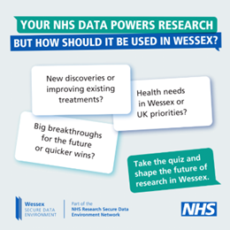
DATE & ACTION | PLATFORM | COPY | ASSET
Week 5 – w/c 24 March –poll data | Facebook, LinkedIn and Instagram | The majority of people across Wessex (66%) like the idea of their data being used to improve quality of care. 🩺 🩻💉 54% of people believe the Wessex SDE should prioritise direct health benefits for patients rather than focus on scientific discoveries that could drive future health innovations. What do you think about how we should use NHS data for research? Share your views today: WessexSDE.nhs.uk/have-your-say led by @UHSFT #ImprovingTomorrowsHealth #datasaveslives #healthdata #WessexSDE #PoweredbyNHSData | Download JPG
 | X (nee Twitter) and Bluesky | The majority of people across Wessex (66%) like the idea of their data being used to improve quality of care. 🩺 🩻💉 Share your views: WessexSDE.nhs.uk/have-your-say led by @UHSFT #ImprovingTomorrowsHealth #datasaveslives #healthdata #WessexSDE #PoweredbyNHSData
Week 5 – w/c 24 March - Mother’s Day – public supporter of Wessex SDE | Facebook, LinkedIn and Instagram | With #MothersDay fast-approaching, Poole mum Lindsay Anderson shares why everyone across Wessex needs to get involved in the #ImprovingTomorrowsHealth campaign and have their say on using #healthdata for life-changing research: WessexSDE.nhs.uk/have-your-say 🔬 🧪 🧫 #datasaveslives #healthdata #WessexSDE #PoweredbyNHSData | Download MP4
 | X (nee Twitter) and Bluesky | With #MothersDay fast-approaching, Poole mum Lindsay Anderson shares why everyone across Wessex needs to have their say on using #healthdata for life-changing research: WessexSDE.nhs.uk/have-your-say 🔬 🧪 🧫 #ImprovingTomorrowsHealth #datasaveslives #healthdata #WessexSDE #PoweredbyNHSData
please @ UNIVERSITY HOSPITAL SOUTHAMPTON: @uhsft (Facebook & Instagram)

Slide 10
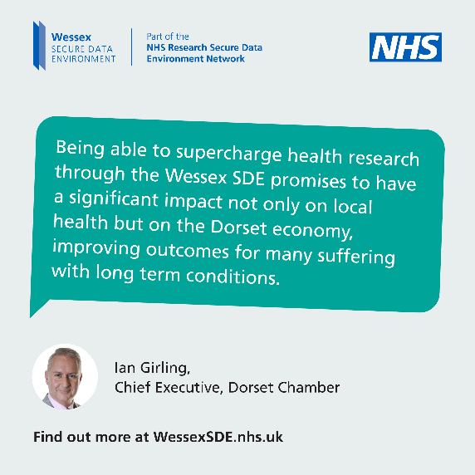
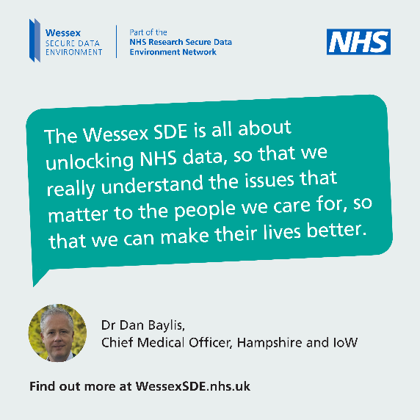
DATE & ACTION | PLATFORM | COPY | ASSET
Week 6 – w/c 31 March – impact on our local economy | Facebook, LinkedIn and Instagram | Ian Girling, Chief Executive @DorsetChamber explains why the Wessex Secure Data Environment stands to benefit the local economy 💰and improve patient outcomes. Take the #ImprovingTomorrowsHealth quiz and find out more about how your de-identified NHS data could be used to power life-saving medical research and better patient care. 🔬🩺 wsde.typeform.com/WessexSDE #ImprovingTomorrowsHealth #datasaveslives #healthdata #WessexSDE #PoweredbyNHSData | Download JPEG
 | X (nee Twitter) and Bluesky | Ian Girling, Chief Executive @ChamberHour explains why the Wessex Secure Data Environment stands to benefit the local economy 💰and improve patient outcomes. #ImprovingTomorrowsHealth #datasaveslives #healthdata #WessexSDE #PoweredbyNHSData
Week 6 – w/c 31 March – why data matters for research | Facebook, LinkedIn and Instagram | Dr Dan Baylis, Chief Medical Officer, explains why the Wessex Secure Data Environment, which uses de-identified NHS data for life-changing research, is so important for people across the region. Everyone across Wessex is being encouraged to share their views on using NHS data for research. 🔬 🧪 🧫 #ImprovingTomorrowsHealth #datasaveslives #healthdata #WessexSDE #PoweredbyNHSData | Download JPEG
 | X (nee Twitter) and Bluesky | Dr Dan Baylis, Chief Medical Officer, @HIOWH_NHSFT explains why the Wessex Secure Data Environment, is so important for people across the region. 🔬 🧪 🧫#ImprovingTomorrowsHealth #datasaveslives #healthdata #WessexSDE #PoweredbyNHSData
please @ dorset chamber: @dorsetchamber (facebook, insta) OR @dorset-chamber (LinkedIn)
please @ Hampshire & isle of wight NHS FT: @hantsiowhealthcarenhsft (Facebook) @HANTSIOWHEALTHCARE_nhsft (insta)

Slide 11
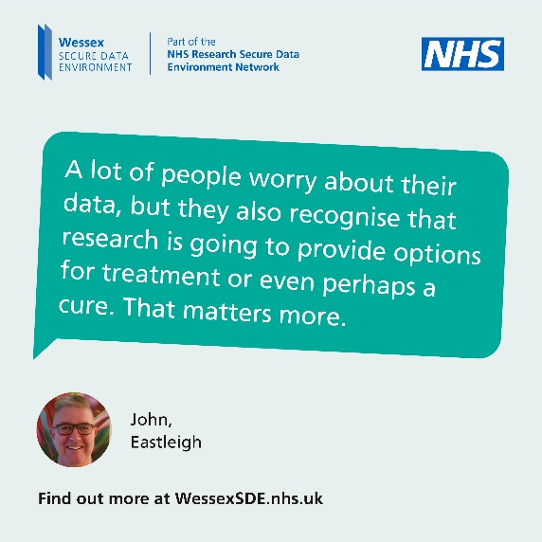
DATE & ACTION | PLATFORM | COPY | ASSET
Week 7 - w/c 7 April – John talks about data worries | Facebook, LinkedIn and Instagram | Eastleigh resident John has been helping the Wessex Secure Data Environment as a critical friend. As someone living with #MultipleSclerosis, John is passionate about research and the power of NHS data to drive change. He reminds us why worrying about data is less important than life-saving research. 🔬 🧪 🧫 #ImprovingTomorrowsHealth #datasaveslives #healthdata #WessexSDE #PoweredbyNHSData | Download JPEG
 | X (nee Twitter) and Bluesky | Eastleigh resident John has been helping the Wessex Secure Data Environment as a critical friend, he shares why we need to support the use of de-identified data for research. 🔬 🧪 🧫 #ImprovingTomorrowsHealth #datasaveslives #healthdata #Wessex SDE #PoweredbyNHSData
Week 7 – w/c 7 April – Sandra talks about hope | Facebook, LinkedIn and Instagram | Fareham mum Sandra shares why using NHS data for research can give communities something vital – hope. Hope for new treatments and breakthroughs. Linking NHS patients’ data helps researchers ask bigger questions and find ways to do things differently – from improving emergency care to developing personalised cancer treatments.💉 She’s encouraging everyone to get involved at WessexSDE.nhs.uk/have-your-say #ImprovingTomorrowsHealth #datasaveslives #healthdata #WessexSDE #PoweredbyNHSData | Download MP4
 | X (nee Twitter) and Bluesky | Fareham mum Sandra shares why using NHS data for research can give communities something vital – hope. Find out more at WessexSDE.nhs.uk/have-your-say led by @UHSFT #ImprovingTomorrowsHealth #datasaveslives #healthdata #WessexSDE #PoweredbyNHSData

Slide 12
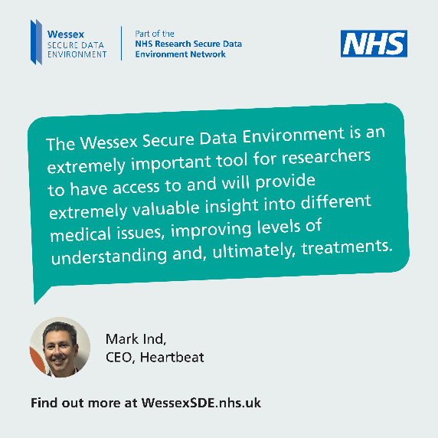
DATE & ACTION | PLATFORM | COPY | ASSET
Week 8 – w/c 14 April – importance of health data for research | Facebook, LinkedIn and Instagram | As the #ImprovingTomorrowsHealth campaign comes to a close this week, Professor Diana Eccles from @uhsft and #healthdata matters to researchers. Sharing your data can pave the way for important breakthroughs that will change lives. 💊💉🧬 Share your thoughts today at WessexSDE.nhs.uk/have-your-say #datasaveslives #WessexSDE #PoweredbyNHSData | Download MP4
 | X (nee Twitter) and Bluesky | As the #ImprovingTomorrowsHealth campaign comes to a close this week, Professor Diana Eccles from @uhsft and #healthdata matters to researchers. Share your views at WessexSDE.nhs.uk/have-your-say #ImprovingTomorrowsHealth #datasaveslives #WessexSDE #PoweredbyNHSData
Week 8 – w/c 14 April – local charity supports Wessex SDE | Facebook, LinkedIn and Instagram | Mark Ind from @UKHeartbeat92 talks about the power of #healthdata and why the Wessex Secure Data Environment matters. Speeding up research into heart disease could have a profound impact on the many babies, children and adults diagnosed with congenital and cardiovascular diseases in the region every year. Sharing your data can pave the way for important breakthroughs that will change lives. 💊💉🧬 Now is your chance to find out more at WessexSDE.nhs.uk/have-your-say #ImprovingTomorrowsHealth #datasaveslives #WessexSDE #PoweredbyNHSData | Download JPEG
 | X (nee Twitter) and Bluesky | Mark Ind from @UKHeartbeat92 talks about the power of #healthdata. Find out more today at WessexSDE.nhs.uk/have-your-say #ImprovingTomorrowsHealth #datasaveslives #WessexSDE #PoweredbyNHSData
please @ UNIVERSITY HOSPITAL SOUTHAMPTON: @uhsft (Facebook & Instagram)
please @ heartbeat: @ukheartbeat (Facebook, INSTA)

Slide 13
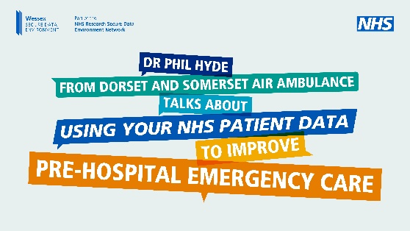
DATE & ACTION | PLATFORM | COPY | ASSET
Week 8 – w/c 14 April – improving emergency services | Facebook, LinkedIn and Instagram | Every serious road collision is a tragedy that affects families forever. But these tragedies aren’t inevitable - they’re preventable. 🚨 Dr Phil Hyde from @UHSFT is leading a "world first" research project to combine road crash data with health records to uncover new insights into traffic collisions that could transform emergency care – and ensure more people make it home safely. 🚨 Find out more: WessexSDE.nhs.uk/have-your-say #datasaveslives #roadsafety #WessexSDE #ImprovingTomorrowsHealth #PoweredbyNHSData | Download MP4
 | X (nee Twitter) and Bluesky | Dr Phil Hyde from @UHSFT talks about how #NHSdata could transform emergency care, save lives and prevent tragedies on our roads. 🚑 Find out more: WessexSDE.nhs.uk/have-your-say #datasaveslives #roadsafety #WessexSDE #PoweredbyNHSData
please @ UNIVERSITY HOSPITAL SOUTHAMPTON: @uhsft (Facebook & Instagram)
Week 8 – w/c 14 April – final post | Facebook, LinkedIn and Instagram | We’re proud to have support the #ImprovingTomorrowsHealth campaign. If you haven’t already, take the #ImprovingTomorrowsHealth quiz today and find out more: wsde.typeform.com/WessexSDE #datasaveslives #healthdata #WessexSDE #PoweredbyNHSData | Download JPG
 | X (nee Twitter) and Bluesky | We’re proud to have support the #ImprovingTomorrowsHealth campaign. Take the #ImprovingTomorrowsHealth quiz today and find out more: wsde.typeform.com/WessexSDE #datasaveslives #healthdata #WessexSDE #PoweredbyNHSData

Slide 14
Newsletter copy & listicles
You can use this new copy in any newsletters you send out or on your website

Slide 15
Newsletter copy: Long version (216 words)
It’s not too late to have your say on the use of NHS data for research
University Hospital Southampton is leading the development of the Wessex Secure Data Environment (Wessex SDE), a new online platform which will use NHS data to improve health outcomes and save lives.
Over the last few weeks, the team has invited people across Dorset, Hampshire and the Isle of Wight to join a public conversation on Improving Tomorrow’s Health.
There’s still time to get involved. Start by taking the #ImprovingTomorrowsHealth quiz: wsde.typeform.com/WessexSDE
The idea of the Wessex SDE is to enable large amounts of de-identified NHS patient data to be safely stored, linked together and made accessible to researchers to improve services and treatments while remaining in the safeguard of the NHS.
Researchers won’t ever see confidential patient information, but they will get access to better quality data, speeding up vital projects like the roll-out of cancer vaccines and earlier diagnosis of lung cancer.
“Using Secure Data Environments like the Wessex SDE, we are developing new early detection tests which have the potential to tell us how likely it is a patient has cancer, reassure those that don’t and speed up diagnosis in those that do”, Dr Victoria Goss, University of Southampton.
To be part of the conversation, go to WessexSDE.nhs.uk/have-your-say.

Slide 16
Newsletter copy: Short version (95 words)
It’s not too late to have your say on the use of NHS data for research
University Hospital Southampton is leading the development of the Wessex Secure Data Environment (Wessex SDE), a new online platform which will use NHS data to improve health outcomes and save lives.
Over the last few weeks, the team has invited people across Dorset, Hampshire and the Isle of Wight to join a public conversation on Improving Tomorrow’s Health.
There’s still time to get involved. Start by taking the #ImprovingTomorrowsHealth quiz: wsde.typeform.com/WessexSDE and be part of the conversation today: WessexSDE.nhs.uk/have-your-say.

Slide 17
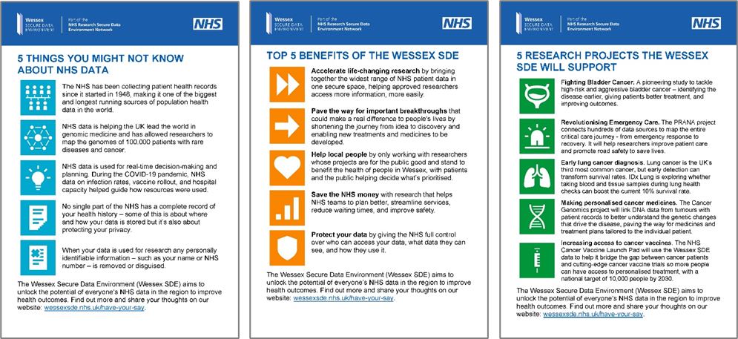
Listicles
The listicles in this toolkit are designed to simplify key messages about NHS data and the Wessex Secure Data Environment (SDE).
Each listicle highlights essential insights, benefits, or real-world research examples, making complex topics accessible and engaging.
Download a ZIP file of all the listicles as images, MS Word document, and PDF: Download ZIP
Cut and paste copy from the pages the follow.

Slide 18
5 things you might not know about NHS data
The NHS has been collecting patient health records since it started in 1948, making it one of the biggest and longest running sources of population health data in the world.
NHS data is helping the UK lead the world in genomic medicine and has allowed researchers to map the genomes of 100,000 patients with rare diseases and cancer.
NHS data is used for real-time decision-making and planning. During the COVID-19 pandemic, NHS data on infection rates, vaccine rollout, and hospital capacity helped guide how resources were used.
No single part of the NHS has a complete record of your health history – some of this is about where and how your data is stored but it’s also about protecting your privacy.
When your data is used for research any personally identifiable information such as your name or NHS number is removed or disguised.
The Wessex Secure Data Environment (Wessex SDE) aims to unlock the potential of everyone’s NHS data in the region to improve health outcomes. Find out more and share your thoughts on our website: https://wessexsde.nhs.uk/.

Slide 19
Top 5 benefits of the Wessex SDE
The Wessex SDE will:
Accelerate life-changing research by bringing together the widest range of NHS patient data in one secure space, helping approved researchers access more information, more easily.
Pave the way for important breakthroughs that could make a real difference to people’s lives by shortening the journey from idea to discovery and enabling new treatments and medicines to be developed.
Help local people by only working with researchers whose projects are for the public good and stand to benefit the health of people in Wessex, with patients and the public helping decide what’s prioritised.
Save the NHS money with research that helps NHS teams to plan better, streamline services, reduce waiting times, and improve safety.
Protect your data by giving the NHS full control over who can access your data, what data they can see, and how they use it.
The Wessex Secure Data Environment (Wessex SDE) aims to unlock the potential of everyone’s NHS data in the region to improve health outcomes. Find out more and share your thoughts on our website: WessexSDE.nhs.uk/have-your-say.

Slide 20
5 research projects the Wessex SDE will support
Researchers will use the Wessex SDE to access patient data safely, quickly, and easily to answer a huge variety of questions, discover life-changing new treatments and medicines, and make the health and social care system more efficient, effective and safe. Five research projects the SDE will help:
Fighting Bladder Cancer. A pioneering study to tackle high-risk and aggressive bladder cancer – identifying the disease earlier, giving patients better treatment, and improving outcomes.
Revolutionising Emergency Care. The PRANA project connects hundreds of data sources to map the entire critical care journey - from emergency response to recovery. It will help researchers improve patient care and promote road safety to save lives..
Early lung cancer diagnosis. Lung cancer is the UK’s third most common cancer, but early detection can transform survival rates. IDx Lung is exploring whether taking blood and tissue samples during lung health checks can boost the current 10% survival rate.
Making personalised cancer medicines. The Cancer Genomics project will link DNA data from tumours with patient records to better understand the genetic changes that drive the disease, paving the way for medicines and treatment plans tailored to the individual patient.
Increasing access to cancer vaccines. The NHS Cancer Vaccine Launch Pad will use the Wessex SDE data to help it bridge the gap between cancer patients and cutting-edge cancer vaccine trials so more people can have access to personalised treatment, with a national target of 10,000 people by 2030.
The Wessex Secure Data Environment (Wessex SDE) aims to unlock the potential of everyone’s NHS data in the region to improve health outcomes. Find out more and share your thoughts on our website: WessexSDE.nhs.uk/have-your-say.

Slide 21
Onsite collateral
This section includes materials you can use on-location – posters to put up or leaflets to hand out at events or leave in venues. You can also use them on your websites.

Slide 22
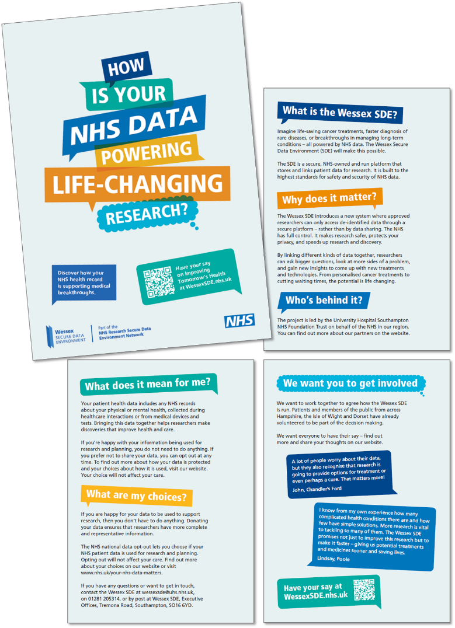
Posters and leaflets
Promote the campaign with our eye-catching posters, available in A4, A3, and A2 sizes. Each poster features a QR code linking directly to the campaign website.
Download PDF
To request copies, simply contact the project team with the quantities and sizes you need.
Our A5 leaflet provides a clear and concise introduction to the Wessex Secure Data Environment, highlighting how data-driven research supports health improvements. It explains patient choice, including opt-out options, and outlines ways to get involved. Perfect for sharing at events or in community spaces.
Download PDF
Contact us to order the copies you need.

Slide 23
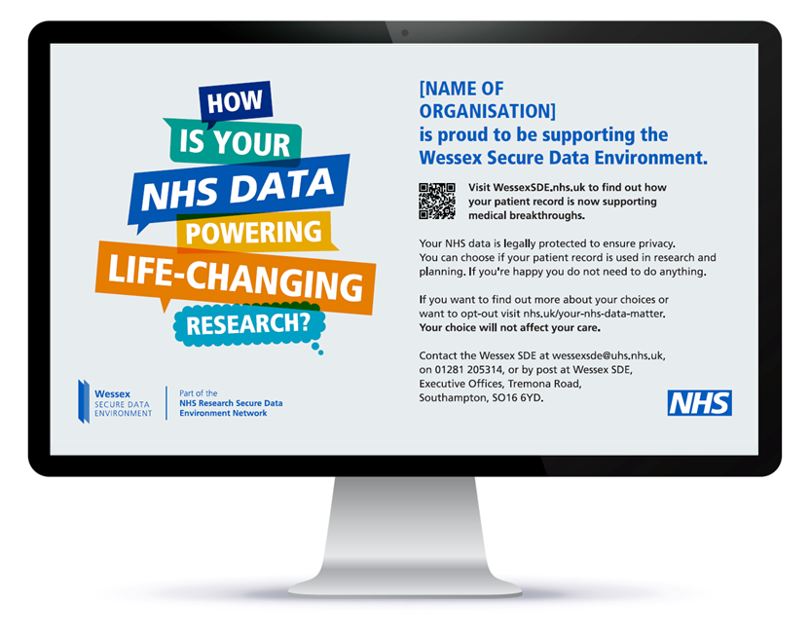
Digital screens content
Put the campaign on your digital screens using our scalable content. Get in touch for a version tailored to your organisation – or download a generic version using the link below:
Download ZIP

Slide 24
Speakers for your events
Talk to us about having someone come and speak at events you are running.

Slide 25
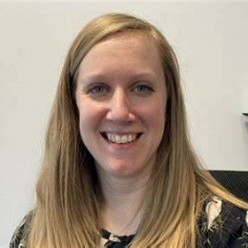
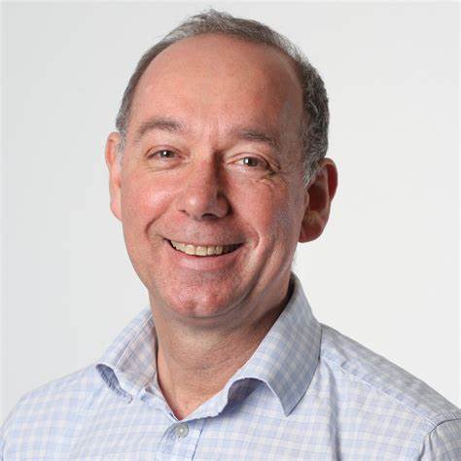
Speakers
We’d love to come and speak about the Wessex SDE any upcoming events. We can provide access to a range of speakers.
To make a request, please contact us using the details at the end of this document.
The campaign will run until the mid-April 2025 and we’d be happy to attend any events before then, where possible.
Researchers excited about the impact of the Wessex SDE on their work, like Professor Sarah Ennis and Dr Victoria Goss who are working on cancer genomics and vaccines, or Dr Phil Hyde who is doing research into improving emergency care.
Our Digital Critical Friends – members of the Wessex public who’ve volunteered to act as a sounding board as the project develops.
Project leads like Professor Chris Kipps and Mark Heffernan who can talk about how the Wessex SDE will work and answer any questions on how we ensure we navigate the use of data safely and effectively to drive real improvements for patients across the region.

Slide 26
Additional content
You can use this content on your website or social channels.

Slide 27
Promote the quiz!
We've created a quiz where your audiences can share their thoughts on the values, rules, and priorities that will guide the Wessex SDE.
By sharing this quiz, you’ll help ensure the platform reflects the needs of all our communities.
You can download the social media asset here:
Download JPG
SOCIAL POST COPY
The NHS in Wessex is building the Wessex Secure Data Environment (SDE) to keep NHS data safe while powering life-saving research. 🏥✨ Take a quick quiz to share your views on how this platform should work. Your views will shape the rules, values, and priorities for how it is run. 🌟 Your voice matters! 👉 Click here to take part: wsde.typeform.com/WessexSDE #datasaveslives #WessexSDE #HealthData #ImprovingTomorrowsHealth

Slide 28
Animation: How does the SDE work?
Our animation explains how the SDE enables secure, ethical use of data to improve treatments and the NHS. Share it with one of the posts below.
Download MP4
💡Did you know your NHS patient data could help save lives? The Wessex Secure Data Environment makes it possible to access data safely for life-saving research. 🔗 Learn more and have your say at wessexsde.nhs.uk/have-your-say – led by @UHSFT #ImprovingTomorrowsHealth #datasaveslives #healthdata #WessexSDE | ⚡ Your NHS patient data is powering life-changing research. The Wessex SDE makes sure this happens in a way that people can trust – keeping your data safe and private. 🔗 Learn more and have your say at wessexsde.nhs.uk/have-your-say – led by @UHSFT #ImprovingTomorrowsHealth #datasaveslives #healthdata #WessexSDE

Slide 29
What others are saying: Our quotes bank
DOWNLOAD ZIP FILE
Download our quotes bank to find inspiring messages from doctors, researchers and public contributors about the Wessex SDE.
We have over 20 ready-made social media graphics you can use to drive action. Just click the link below to download a ZIP file of all the assets:
Download ZIP

Slide 30
Videos to inspire and start a discussion
Explore our video library to hear researchers explain how NHS patient data powers groundbreaking studies, discover how the Wessex SDE accelerates research, and see public contributors share their reflections. Download or share these videos anytime to inspire others.
Click the link below to go to the Toolkit page on our website, where you van view and download the videos you want:
Visit Video Library
VISIT VIDEO LIBRARY

Slide 31
Get in touch
If you have any questions or want to get in touch. Give us a call or an email and we will do our best to help!
Thank you for your time and support!
MEDIA & CAMPAIGN INQUIRIES
Please contact:
Fiona Beveridge E: fiona.beveridge@opyn.consulting M: 07729 613 997
Ralph Scott E: ralph.scott@opyn.consulting M: 07951 572065
PUBLIC INQUIRIES
E: wessexsde@uhs.nhs.uk
T: 02381 205314
Wessex SDE Executive Offices Tremona Road Southampton SO16 6YD.

